Slide 1
ESQC 2026
Mathematical Methods Lecture 5
By Simen Kvaal

Slide 2
Today’s agenda
We are already familiar with calculus, vector calculus, and linear algebra
We will have a look at some more advanced mathematical tools
Hilbert space
Fourier analysis

Slide 3
Introduction to Hilbert space

Slide 4
Motivation
Previously, we studied
What if we want to optimize not a vector but a function?
Can we have something like:

Slide 5
Calculus of variations
Yes, indeed: calculus of variations gives the language
Now, we will look at the language for the last part: infinite dimenional vector spaces
Eigenvalue equation in Hilbert space

Slide 6
Functions as vectors
A function can be viewed as a vector, since we can take linear combinations:
What is the dimension of such a vector space?
We can try to approximate with samples:

Slide 7
Inner product between functions
Compare inner product between vectors and Riemann sum
Indicates that the inner product between functions could be:

Slide 8
Hilbert space
In quantum mechanics Hilbert space is (typically) a vector space of functions
It has an inner product given by integrating functions against each other
Example: Hilbert space of orbitals
«Square-integrable» functions over R³

Slide 9
NB!
Point of possible confusion:
A 3D vector
New vector = function of a vector

Slide 10
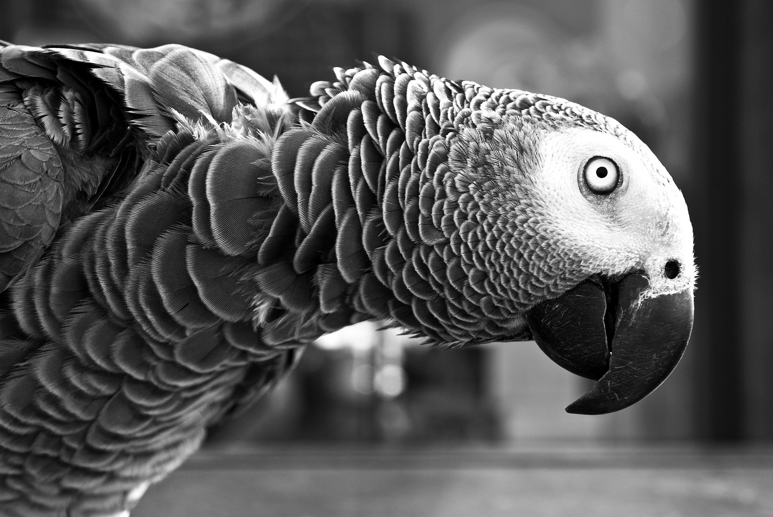
Demo
(There is nothing special about )
Demo: lecture-5-functions-as-vectors.ipynb

Slide 11
Matrices become operators
In Hilbert space, a linear transformation can act on every point
It can be thought of as an infinite matrix
Can contain partial differential operators

Slide 12
Demo
We revisig lecture-5-functions-as-vectors.ipynb
We revisit lecture-2-diagonalization.ipynb
We see that operators can be unbounded

Slide 13
Finite dimensional linear algebra
Hilbert space
Vector x
Vector space
Inner product
Norm
Orthogonality
Basis vectors
Matrix
Eigenvector
Function – state
Hilbert space
Inner product
Norm
Orthogonality
Basis functions
Linear operator
Eigenfunction

Slide 14
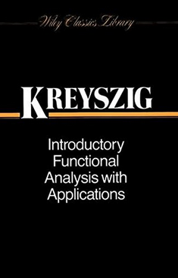
Functional analysis
The study of infinite dimensional vector spaces
The operators acting on these
Typically: Spaces of functions
Extremely important topic for the study of partial differential equations

Slide 15
Fourier analysis

Slide 16
Coplex phase factors
We recall Euler’s formula

Slide 17
Epicycles of planetary motion
Ptolemaic and Copernican system of astronomy was geocentric
But observations required epicycles
An early form of Fourier series

Slide 18
Epicycles of planetary motion
Ptolemaic and Copernican system of astronomy was geocentric
But observations required epicycles
An early form of Fourier series
(The ancient Greeks did not use complex numbers)

Slide 19
Epicycles upon epicycles ...
By adding more epicycles, virtually any plane curve can be drawn
In fact alpmost any complex function over an interval can be written as a Fourier series
Demo: lecture-5-epicycles.ipynb

Slide 20
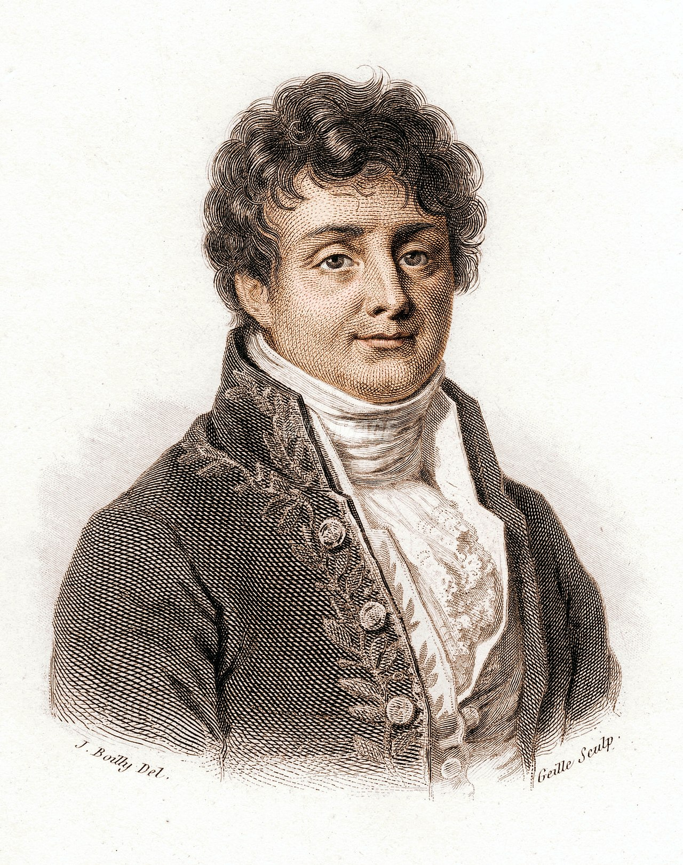
Joseph Fourier (1768-1830)
Had the idea that general periodic functions could be decomposed into sinusoidal components
A function of period T:

Slide 21
Fourier series as Hilbert space basis expansion
Recall an orthonormal basis expansion in finite dimensions:
For a function
Orthonormal basis
Infinite basis expansion!

Slide 22
Plane waves and derivatives
Consider a plane wave:
Eigenfunction for differentiation:
Differentiation becomes multiplication for the plane wave
Duality of position and momentum in quantum mechanics

Slide 23
Fourier transform
We can generalize Fourier series to almost arbitrary functions:
The (normalized) Fourier transform is defined as:
Fact: The transform is a unitary transformation
Plane wave basis function

Slide 24
Generalization to higher dimensions
Normalized Fourier transform and inverse:
Again, a unitary transformation

Slide 25
Example
Demo: lecture-5-image-fourier.ipynb

Slide 26
A few reasons why we need Fourier analysis
Often signals are naturally decomposed into plane waves:
Spectroscopy: time vs. frequency
Quantum mechanics: Duality of position and momentum
Derivatives become multiplication
Plane-wave electronic-structure methods (solid state)
... and more

Slide 27
End of lecture 5
Thanks for joining the journey!
Make sure you check out the maps online
Feedback welcome!

